Slide 1
Face Recognition Based ATM Security
*Your Name

Slide 2
INTRODUCTION
OpenCV is one of the most popular computer vision libraries. If you want to start your journey in the field of computer vision. In this article, I will try to introduce the most basic and important concepts of OpenCV in an intuitive manner.
Reading an image
Extracting the RGB values of a pixel
Extracting the Region of Interest (ROI)
Resizing the Image
Rotating the Image
Drawing a Rectangle
Displaying text

Slide 3
OPEN CV
OpenCV for people counting, image processing and deep learning object detector are used. This method leverages both object detection and tracking to improve the accuracy of the people counter. Single image crowd counting method evaluates the number of people in the crowded image.

Slide 4
TRAINING
CUSTOMER DETAILS
TAKE IMAGE
CAMERA OPEN
FACE DETECTION
OPENCV
VIDEO TO IMAGE
BIOMETRIC CHARACTERISTIC
SAVE PROFILE
TRAIN MODEL

Slide 5
ALGORITHM
Convolutional Neural Networks
To address this problem, bionic convolutional neural networks are proposed to reduced the number of parameters and adapt the network architecture specifically to vision tasks.
Convolutional neural networks are usually composed by a set of layers that can be grouped by their functionalities.

Slide 6
Convolution Layer
The process is a 2D convolution on the inputs.
The “dot products” between weights and inputs are “integrated” across “channels”.
Filter weights are shared across receptive fields.
The filter has same number of layers as input volume channels, and output volume has same “depth” as the number of filters.

Slide 7
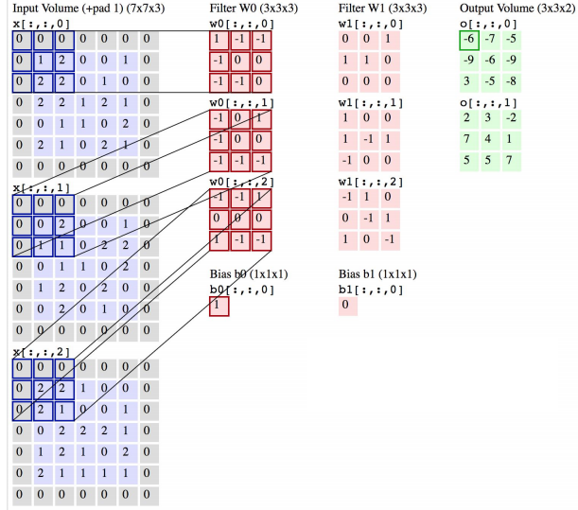

Slide 8
POOLING LAYER
Convolutional layers provide activation maps
Pooling layer applies non-linear down sampling on activation maps.
Pooling is aggressive (discard info); the trend is to use smaller filter size and abandon pooling.

Slide 9
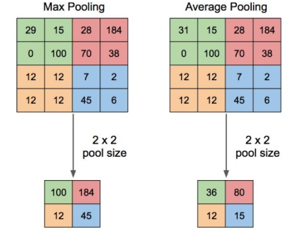

Slide 10
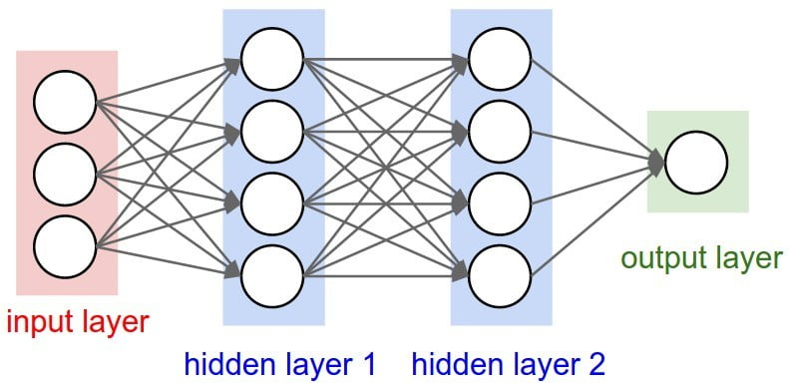
FULLY CONNECTED LAYER

Slide 11
INPUT LAYER
The input layer of a neural network is composed of artificial input neurons, and brings the initial data into the system for further processing by subsequent layers of artificial neurons.
The input layer is the very beginning of the workflow for the artificial neural network.
HIDDEN LAYER
In neural networks, a hidden layer is located between the input and output of the algorithm.
In which the function applies weights to the inputs and directs them through an activation function as the output.

Slide 12
OUTPUT LAYER
The last layer is the output layer, which directly links to the target value that the model attempts to predict.

Slide 13
TESTING
CAMERA
IMAGE CAPTURING
OPEN CV
FACE RECOGNITION
COMPARE WITH TRAINED MODEL
FACE DETECTION
DISPLAY CUSTOMER DETAILS

